Slide 1
Graduate Attribute Assessment Workshop
Brian Frank
Director (Program Development)
Faculty of Engineering and Applied Science
Queen's University
February 4, 2011
Please sit at tables with people from your department if possible.

Slide 2
Session outcomes
1. Apply accepted assessment principles to CEAB graduate attribute requirements
2. Plan a process to generate data that can inform program improvement
Be able to use:
  Tools
  Technology
  Terminology

Slide 3
Administrative issues
Questions/issues/
discussion?
Ask!
Paper
Resources being added to http://engineering.queensu.ca/egad
Summary handout for reference (terminology, process)
Active workshop - feel free to ask questions or comment throughout

Slide 4
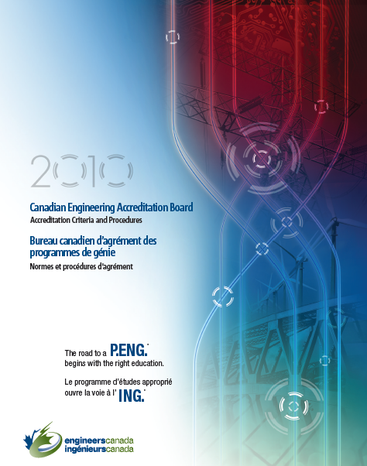
Perspective: Sec 3.1 of CEAB Procedures
“The institution must demonstrate that the graduates of a program possess the attributes under the following headings... There must be processes in place that demonstrate that program outcomes are being assessed in the context of these attributes, and that the results are applied to the further development of the program.”

Slide 5
Background
Accreditation bodies in most industrialized countries use outcomes-based assessment to demonstrate their students' capabilities.
Washington Accord: allows substantial equivalency of graduates from Australia, Canada, Hong Kong, Republic of Ireland, New Zealand, South Africa, United Kingdom, and United States, Japan, Singapore,Korea, and Chinese Taipei
Discussions by CEAB and National Council of Deans of Engineering and Applied Science (NCDEAS) led to graduate attribute expectations in 2008

Slide 6
National Response
NCDEAS set up pilot projects running at 6 universities (Dalhousie, Guelph, UBC, Calgary, Toronto, Queen’s)
Representatives have run workshops at NCDEAS, Queen's, Toronto, Dalhousie, UBC, RMC, and CEEA 2010 Conference
Engineering Graduate Attribute Development (EGAD) project sponsored by NCDEAS formed by representatives from those schools, started Jan 2011

Slide 7
Graduate attribute assessment
Outcomes assessment is used to answer questions like:
What can students do?
How does their performance compare to our stated expectations?
It identifies gaps between our perceptions of what we teach and what knowledge, skills, and attitudes students develop program-wide.

Slide 8
Inputs and Outcomes
Inputs Student pre-university background Faculty education, professional status Ongoing faculty development Class sizes Content Campus resources Contact hours Laboratory equipment Support services | Outcomes Demonstrated abilities (cognitive, skills, attitudes)

Slide 9
Outcomes assessment widely used
Common in the Canadian primary, secondary, and community college educational systems
National recommendations from provincial Ministers of Education, now required for all Ontario post-secondary programs: Undergraduate Degree-Level Expectations (OCAV UDLEs)
    Depth and Breadth of Knowledge
    Knowledge of Methodologies
    Application of Knowledge
    Communication Skills
    Awareness of Limits of Knowledge
    Autonomy and Professional Capacity

Slide 10
Good news:
Most programs probably already have people doing this on a small scale:
Some instructors already use course learning outcomes
Design course instructors often assess design, communications, teaming skills
Rubrics are becoming common for assessing non-analytical outcomes
Can identify innovators and key instructors (e.g. project-based design courses, communications, economics)

Slide 11

Setting up a process
(without overwhelming faculty and irritating staff)

Slide 12
CEAB graduate attributes (Sec 3.1)
Knowledge base
Design
Problem analysis
Individual and team work
Communication skills
Investigation
Professionalism
Use of engineering tools
Impact on society and environment
Ethics and equity
Engineering science
Economics and project management
Laboratory
Lifelong learning
Project/experiential

Slide 13
Questions for programs:
What are your program's specific
and measurable expectations ?
How will you measure the students
against specific expectations?
Given requirements:
Assess in 12 broad areas (graduate attributes), and
create a process for program improvement.
Processes in place for analyzing data
and using it for improvement?
Where to measure the expectations
(courses, internships,
extra-curriculars...)?

Slide 14
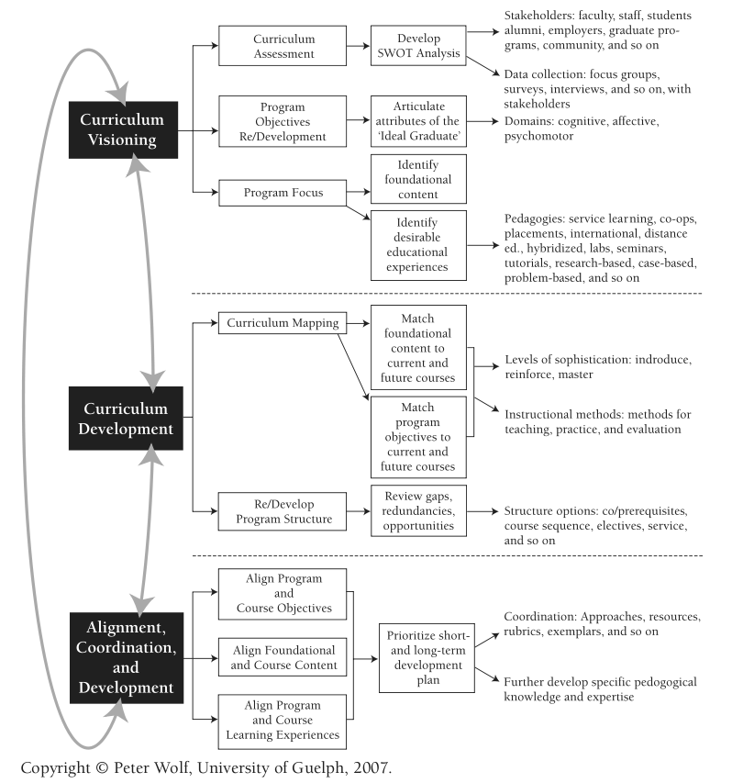
Example of comprehensive curriculum design overview
by P. Wolf at U Guelph
From P. Wolf, New Directions for Teaching and Learning,
Volume 2007, Issue 112 (p 15-20). Used with permission.

Slide 15
CEAB GA assessment instructions (2010)
Describe the processes that are being or are planned to be used. This must include:
a set of indicators that describe specific abilities expected of students to demonstrate each attribute
where attributes are developed and assessed within the program…
how the indicators were or will be assessed. This could be based on assessment tools that include, but are not limited to, reports, oral presentations, …
evaluation of the data collected including analysis of student performance relative to program expectations
discussion of how the results will be used to further develop the program
a description of the ongoing process used by the program to assess and develop the program as described in (a)-(e) above

Slide 16
Course development process
Identify course
objectives and
content
Create specific
outcomes for each
class
Course
improvement
Student input
Map to experiences
(lectures, projects,
labs, etc.)
Analyze and
evaluate data
Course changes/
Measure
Identify appropriate
tools to assess
(reports, simulation,
tests,...)

Slide 17
Program-wide assessment process flow
Identify major
objectives (including
graduate attributes)
Create
Indicators
Program
improvement
Stakeholder input
Map to courses/
experiences
Analyze and
evaluate data
Course changes/
Measure
Identify appropriate
tools to assess
(reports, simulation,
tests,...)

Slide 18
Assessment principles (adapted from ABET)
Assessment works best when the program has clear objectives.
Assessment requires attention to both outcomes and program.
Assessment should be periodic, not episodic
Assessment should be part of instruction

Slide 19
Program-wide assessment process flow
Identify major
objectives (including
graduate attributes)
Create
Indicators
Program
improvement
Stakeholder input
Map to courses/
experiences
Analyze and
evaluate data
Course changes/
Measure
Identify appropriate
tools to assess
(reports, simulation,
tests,...)

Slide 20
Creating Program objectives
CEAB graduate attributes
Strategic plans
Advisory boards
Major employers of graduates
Input from stakeholders
Focus groups, surveys
SWOT (strengths, weaknesses, opportunities, threats) analysis
What do you want your program to be known for?

Slide 21
Program-wide assessment process flow
Identify major
objectives (including
graduate attributes)
Create
Indicators
Program
improvement
Stakeholder input
Map to courses/
experiences
Analyze and
evaluate data
Course changes/
Measure
Identify appropriate
tools to assess
(reports, simulation,
tests,...)

Slide 22
Why performance indicators?
Lifelong learning
An ability to identify and address their own educational needs in a changing
world in ways sufficient to maintain their competence and to allow them to
contribute to the advancement of knowledge
Can this be directly
measured?
Would multiple assessors
be consistent?
How meaningful would
the assessment be?
Probably not, so more specific measurable indicators are needed.
This allows the program to decide what is important

Slide 23
Indicators: examples
Lifelong learning
An ability to identify and address their own educational needs in a changing
world in ways sufficient to maintain their competence and to allow them to
contribute to the advancement of knowledge
Graduate
attribute
The student:
Critically evaluates information
for authority, currency, and
objectivity
Identify gap in knowledge and
develop a plan to address
Indicators
Describes the types of literature of
their field and how it is produced
Uses information ethically and legally
to accomplish a specific purpose

Slide 24
Establishing Indicators
What specific things should students demonstrate?
What do they need to be able to do?
Are they measurable and meaningful?
Can involve cognitive (recalling, analyzing, creating), attitudes, skills
Level of expectation
(“describes”, “compares”, “applies”, “creates”, etc.)
Content area
Critically evaluates information for authority, currency, and
objectivity

Slide 25
Indicators
A well-written indicator includes:
what students will do
the level of complexity at which they will do it
the conditions under which the learning will be demonstrated

Slide 26
Indicators
Examples: knowledge base for engineering (mathematics)
Critically select* and apply* computational formula to solve novel problems
Examples: Design
Generates* original concepts and adapts* existing ones to offer diverse, viable solutions that address the problem definition
Evaluates* the validity and reliability of models against specifications and the criteria established by a client

Slide 27
Problematic criteria
What does the author mean? Students can state
the laws? Plug numbers into equations? Apply laws
to solve conceptual problems? ...
Content area
Learns static physics principles including Newtonian laws
for linear motion

Slide 28
Taxonomy
Creating
(design, construct, generate ideas)
Evaluating
(critique, judge, justify decision)
Analyzing
(compare, organize, differentiate)
Applying
(use in new situation)
Understanding
(explain, summarize, infer)
Remembering
(list, describe, name)
Anderson, L. W. and David R. Krathwohl, D. R., et al (Eds..) (2001) A Taxonomy for Learning, Teaching, and Assessing: A Revision of Bloom's Taxonomy of Educational Objectives. Allyn & Bacon. Boston, MA (Pearson Education Group

Slide 29
Verbs for cognitive skills
Define
List
State
Recall
Identify
Recognize
Calculate
Label
Locate
Interpret
Compare
Contrast
Solve
Estimate
Explain
Classify
Modify
Integrate
Analyze
Hypothesize
Evaluate
Justify
Develop
Create
Extrapolate
Design
Critique
Higher order skills

Slide 30
Outcomes at Blooms’ Levels (Romkey, McCahan):
Knowing: Define the concepts of engineering stress and engineering strain.
Understanding: Explain Hooke’s Law in your own words and describe the conditions under which it is applicable.
Applying: Utilize Poisson’s Ratio to calculate lateral strain given a longitudinal loading situation.
Analysing: Discuss the specific characteristics of the microstructure that render the stress-strain behaviour of a polymeric material as brittle, plastic, or elastic.
Synthesizing: Investigate recyclability/disposability issues relative to (a) metals, (b) glass, (c) polymers, and (d) composites.
Creating: Argue the economic viability of the “green design” philosophy of product design.
30
Notes:
30

Slide 31
Consider these indicators
Students will learn concepts about linear motion.
Students will describe concepts including force, power, energy, and momentum.
Student will work effectively in teams.

Slide 32
Defining Indicators for your Program (10 min)
In groups of 2-4:
  Select a graduate attribute your department hasn’t already considered (teamwork or economics?)
  Independently create some indicators for that attribute that reflect your program objectives
  Discuss indicators at your table. Are they measurable? Are they meaningful? Would the assessment of them be consistent from one rater to another?

Slide 33
Follow-up to identifying Indicators
Any points for discussion?

Slide 34
Resources on Indicators
EC2000, ABET 2009
UK-SPEC, Engineering Subject Centre Guide
Engineers Australia
CDIO
Foundation Coalition
UDLEs
Discipline-specific (Civil Engineering Body of Knowledge, IET criteria for electrical and computer engineering, etc.)
Note: Indicators may also be known as:
Assessment criteria
Performance criteria
Outcomes
Competencies
Objectives
Many linked at:
http://bit.ly/9OSODq
(case sensitive, no zeros)

Slide 35
Program-wide assessment process flow
Identify major
objectives (including
graduate attributes)
Identify
Indicators
Program
improvement
Stakeholder input
Map to courses/
experiences
Analyze and
evaluate data
Course changes/
Measure
Identify appropriate
tools to assess
(reports, simulation,
tests,...)

Slide 36
Indicator mapping
Indicators
First year courses
Design
Physics
Calculus
Chemistry
etc.
First year
Design project course
Assignment 1
used to assess:
Indicator 1
Indicator 2
Indicator 3
Assignment 2
used to assess:
Indicator 1
Indicator 4
Indicator 5
Team proposal
used to assess:
Indicator 1
Indicator 6
Indicator 7
etc.
Middle years
Graduating year

Slide 37
Where can we assess students?
Courses
Co-ops/internships
Co-curricular activities (competitive teams, service learning, etc.)
Exit or alumni surveys/interviews
...

Slide 38
Assessment Mapping
Mapping process focuses on where students should be assessed, not on every course where material is taught
In a typical program the courses involved in assessing students are a small subset of courses. This might include a few courses from areas including:
  Engineering science
  Laboratory
  Complementary studies
  Project/experiential based

Slide 39
Two approaches to mapping
Attributes to courses
“We know what we want the program to look like – how well do the attributes line up with our curriculum?”
Courses to attributes
“Let’s do a survey of our instructors, and determine experiences appropriate to developing and assessing attributes.”
Can do this one way or both ways

Slide 40
Attributes to courses: Lifelong learning
Indicator | Developed | Assessed | Assessment tool(s)
Critically evaluates procured information for authority, currency, and objectivity | APSC-100 MECH-212 MECH-460 | MECH-460 | Project proposal report
 |  | MECH 490 | Oral exam
Describes professional and academic societies in the discipline and how new knowledge enters discipline. | APSC-100 MECH-270 MECH-333 MECH-490 | MECH-490 | Undergraduate thesis
Identifies resources and professional associations that address own ongoing professional development. | MECH-270 MECH-490 Co-op | MECH-490 | Pre-graduation interview
 |  | Co-op | Post co-op report

Slide 41
Courses to attributes: First year
Course | Grad Attributes Supported | Instructional Methods | Assessment tool(s)
APSC-100 (Engineering practice) | Communication Individual & Team Work Professionalism Lifelong Learning Problem analysis (open-ended) Investigation Ethics and equity | Design project Experimental project Model eliciting activity | Project reports Oral presentations Peer evaluations Supervisor evaluation All rubric-based
APSC-171 (Calculus I) | Knowledge Problem analysis (closed-ended) | Lecture, independent work | Targeted question on final exam

Slide 42
More comprehensive mapping table
Indicator | Developed in: | Assessment Method | Measured in: | Time measured | Assessment coordinator | Evaluation
Produces research information for the team | ME113, EM213, ME213, ME235, ME333, ME412 | Portfolios Peer Evaluations, Faculty Evaluations | ME 213 ME412 | ME 213 Even ME412 Odd | Even – Armaly Odd - Richards | Curriculum Committee
Demonstrates understanding of team roles when assigned | ME113, EM213, ME213, ME235, ME333, ME412 | Peer Evaluations, Faculty Evaluations | ME 213 ME412 | ME 213 Even ME412 Odd | Even – Armaly Odd - Richards | Curriculum Committee
Shares in the work of the team | ME113, EM213, ME213, ME235, ME333, ME412 | Peer Evaluations, Faculty Evaluations | ME 213 ME412 | ME 213 Even ME412 Odd | Even – Armaly Odd - Richards | Curriculum Committee
Demonstrates good listening skills | ME113, EM213, ME213, ME235, ME333, ME412 | Peer Evaluations, Faculty Evaluations | ME213 ME412 | ME 213 Even ME412 Odd | Even – Armaly Odd - Richards | Curriculum Committee

Slide 43
Curriculum mapping surveying
U Guelph developing Currickit: Curriculum Mapping Software
  Online survey, completed by each instructor, to describe whether an attribute is developed, assessed, or both
  Software collects data and reports on attributes in the program
U Calgary surveyed instructors to find out where attributes are Introduced, Developed, or Utilized (ITU) in courses

Slide 44
ITU Analysis: Introduced
Source: B. Brennan, University of Calgary

Slide 45
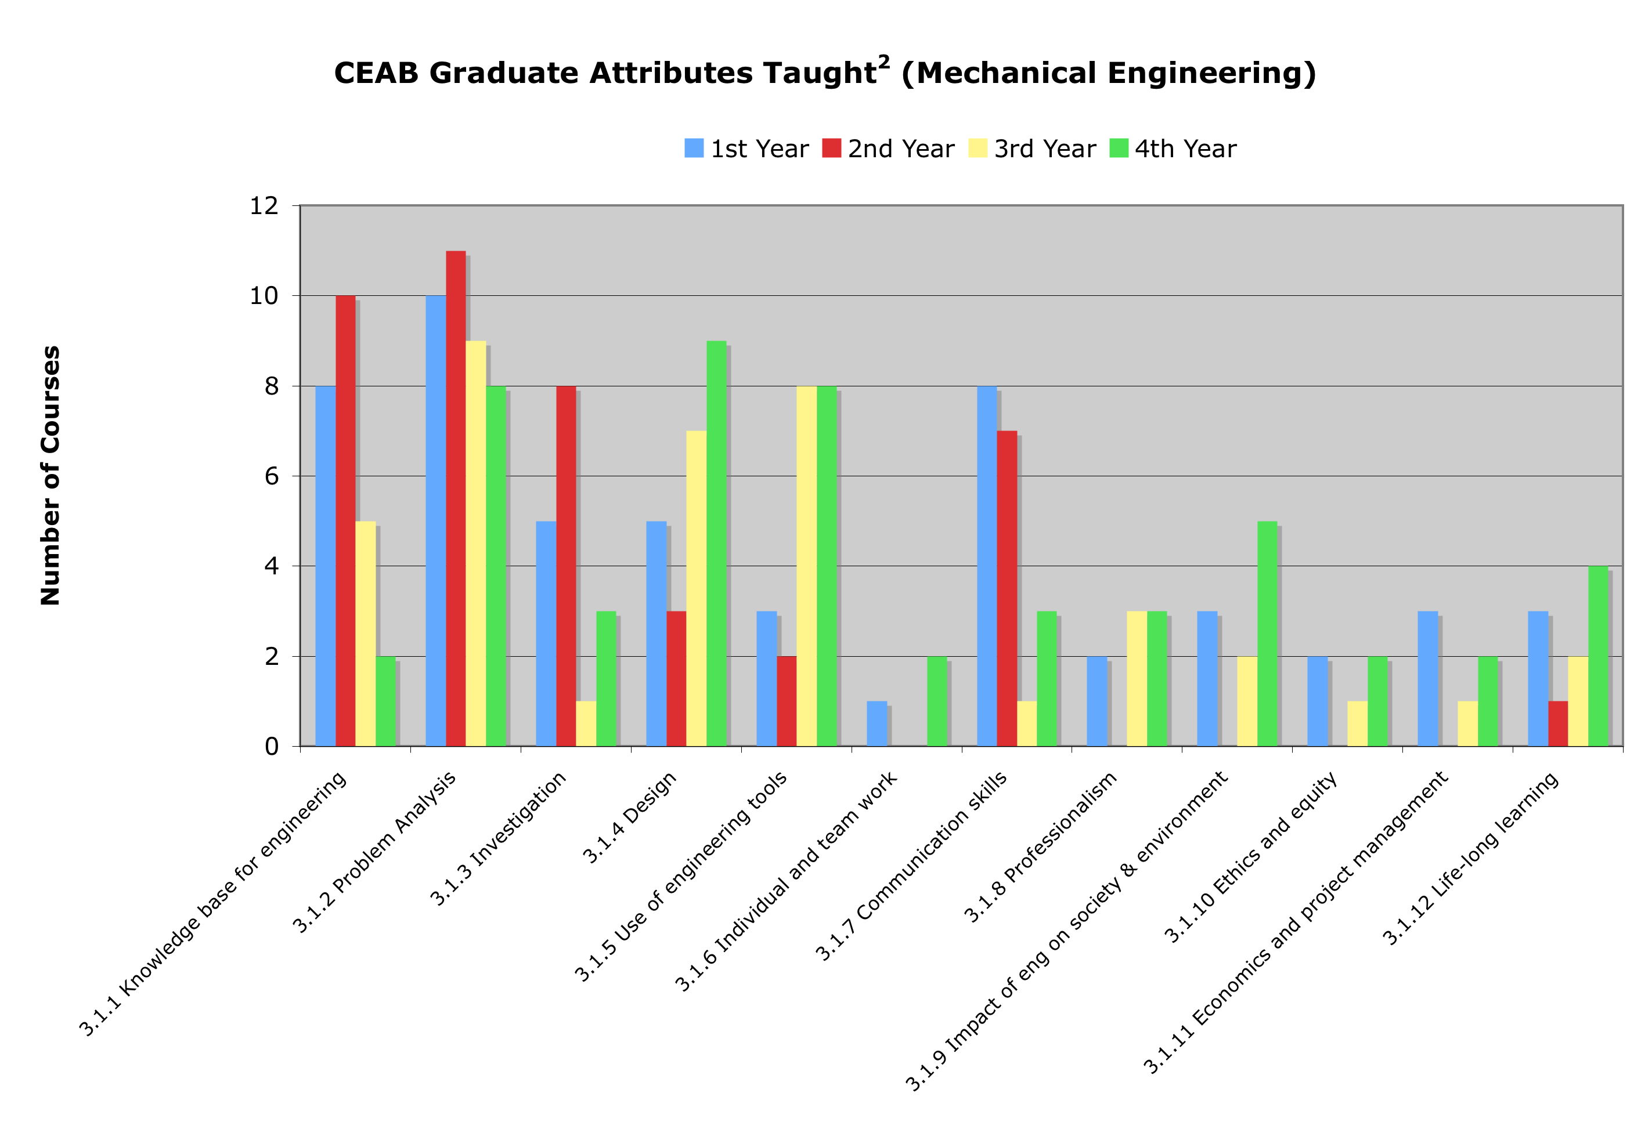
ITU Analysis: Taught
Source: B. Brennan, University of Calgary

Slide 46
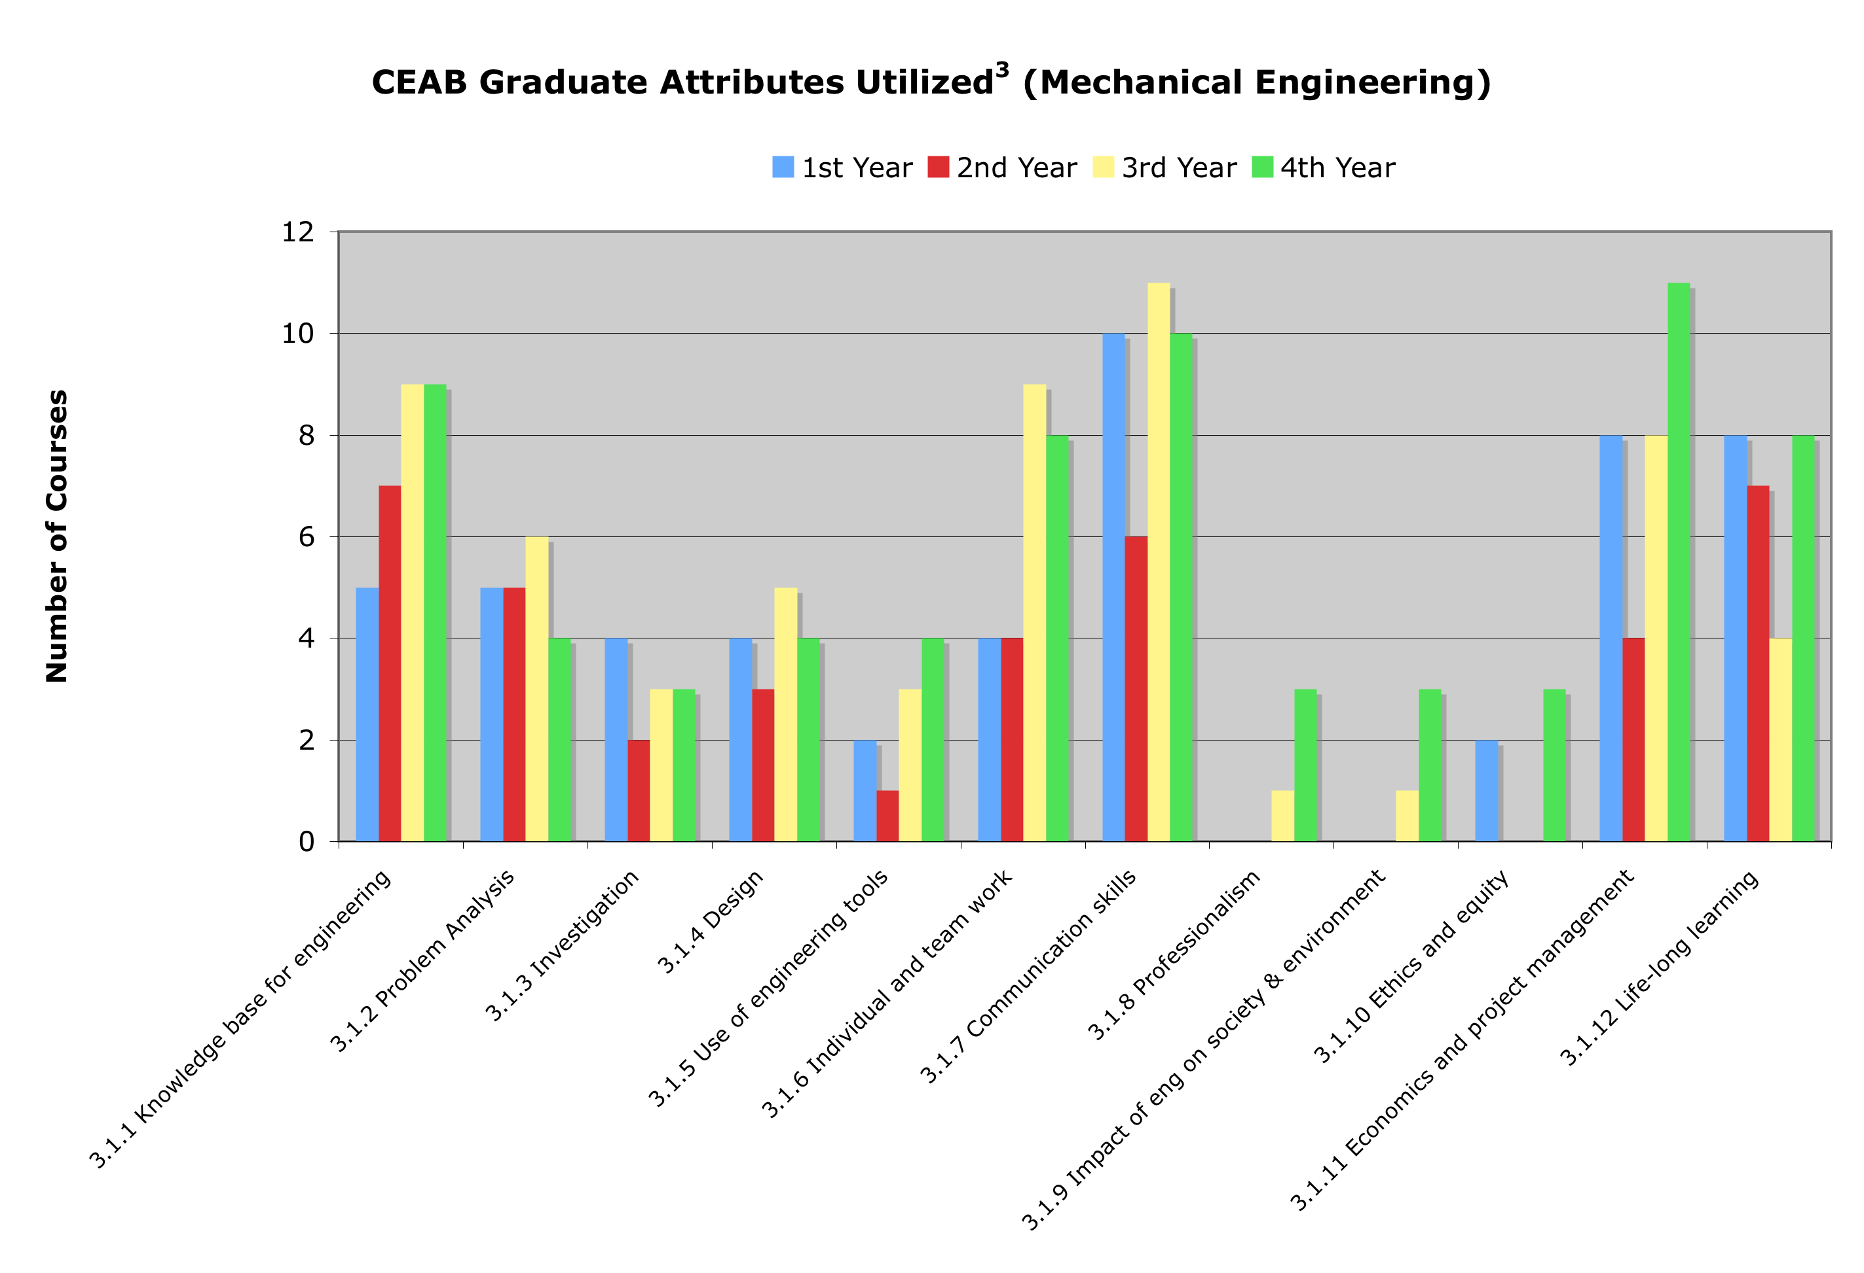
ITU Analysis: Utilized
Source: B. Brennan, University of Calgary

Slide 47
Program-wide assessment process flow
Identify major
objectives (including
graduate attributes)
Identify
indicators
Program
improvement
Stakeholder input
Map to courses/
experiences
Analyze and
evaluate data
Course changes/
Measure
Identify appropriate
tools to assess
(reports, simulation,
tests,...)

Slide 48
Assessment tools
How to measure learning against specific expectations?
Direct measures – directly observable or measurable assessments of student learning
  E.g. Student exams, reports, oral examinations, portfolios, etc.
Indirect measures – opinion or self-reports of student learning or educational experiences
  E.g. grades, student surveys, faculty surveys, focus group data, graduation rates, reputation, etc.

Slide 49
Assessment tools
Local written exam
(e.g. question on final)
External examiner
(e.g. Reviewer on design projects)
Standardized written exam
(e.g. Force concept inventory)
Oral exam
(e.g. Design projects presentation)
Performance appraisal
(e.g. Lab skill assessment)
Oral interviews
Simulation
(e.g. Emergency simulation)
Surveys and questionnaires
Behavioural observation
(e.g. Team functioning)
Focus group
Portfolios
(student maintained material addressing
outcomes)
Archival records
(registrar's data, previous records, ...)

Slide 50
Instructors: “We do assess outcomes – by grades”
How well does the program prepare
students to solve open-ended
problems?
Student transcript
Electric Circuits I Electromagnetics I Signals and Systems I Electronics I Electrical Engineering Laboratory Engineering Communications Engineering Economics ... Electrical Design Capstone | 78 56 82 71 86 76 88 86
Are students prepared to continue
learning independently after
graduation?
Do students consider the social
and environmental implications of
their work?
What can students do with
knowledge (plug-and-chug vs.
evaluate)?
Course grades usually aggregate
assessment of multiple objectives,
and are indirect evidence for
some expectations

Slide 51
External assessment tools
Concept inventories (Force Concept Inventory, Statics concept inventory, Chemistry Concept Inventory, …)
Surveys of learning, engagement, etc.
  National Survey of Student Engagement (National data sharing, allowing internal benchmarking), E-NSSE
  Course Experience Questionnaire
  Approaches to Studying Inventory
  Academic motivation scale
  Engineering attitudes survey

Slide 52
Targets and thresholds
Need to be able to explain what level of performance is expected of students
Useful to consider the minimum performance expectation (threshold) and what a student should be able to do (target)
Rubrics can be very useful

Slide 53
Rubrics
Scales Dimensions | Not demonstrated | Marginal | Meets expectations | Exceeds expectations
Dimension 1: Information | Descriptor | Descriptor | Descriptor | Descriptor
Dimension 2: Design | Descriptor | Descriptor | Descriptor | Descriptor
Dimension 3: Communications | Descriptor | Descriptor | Descriptor | Descriptor
Improve inter-rater reliability
Describe expectations for instructor and students

Slide 54
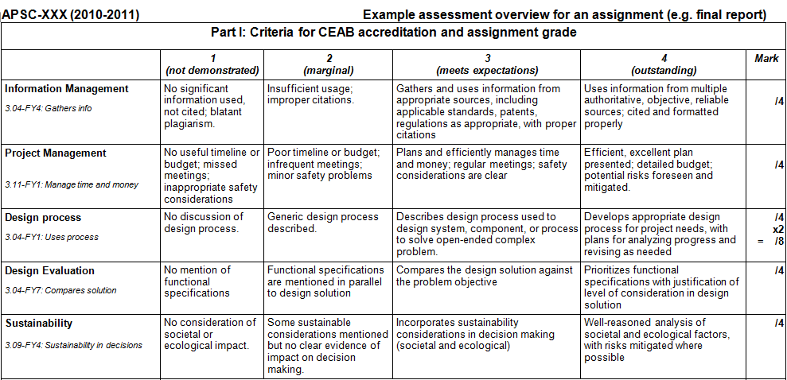
Rubric example
threshold
target
Creating defined levels (“scales”) of expectations reduces variability between graders, makes expectations clear to students

Slide 55
Task: Assessment tools (5 min)
Take some assessment criteria developed by group previously:
  Determine three ways that they could be assessed (a list of assessment tools are on summary sheet), at least one done using a direct assessment tool
  If any are difficult to measure, consider whether the criteria should be modified

Slide 56
Example: Knowledge assessment
Calculus instructor asked questions on exam that specifically targeted 3 assessment criteria for “Knowledge”:
  “Create mathematical descriptions or expressions to model a real-world problem”
  “Select and describe appropriate tools to solve mathematical problems that arise from modeling a real-world problem”
  “Use solution to mathematical problems to inform the real-world problem that gave rise to it”
Notes:
56

Slide 57
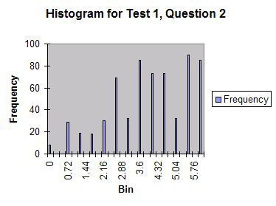
Indicator 1:
The student can create and/or select mathematical descriptions or expressions for simple real-world problems involving rates of change and processes of accumulation (overlaps problem analysis)
Context: calculating
Intersection of two
trajectories

Slide 58
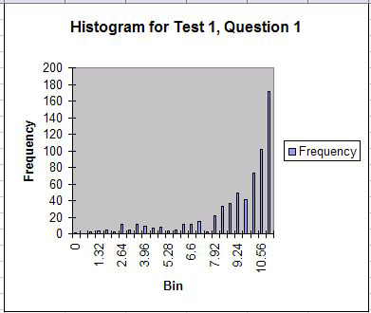
Indicator 2:
Students can select and describe appropriate tools to solve the mathematical problems that arise from this analysis
Context: differentiation
similar to high school
curriculum

Slide 59
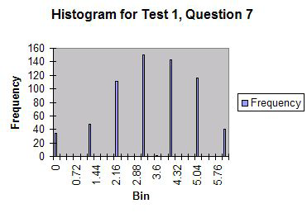
Indicator 2:
Students can select and describe appropriate tools to solve the mathematical problems that arise from this analysis
Context: implicit
differentiation, trig
inverse

Slide 60
Example: Knowledge assessment
Physics course instructors administering the Force Concept Inventory (FCI) before and after course in mechanics to assess conceptual understanding
Allows for benchmarking, which is difficult to do for most other indicators.
Notes:
60

Slide 61
Program-wide assessment process flow
Identify major
objectives (including
graduate attributes)
Identify
indicators
Program
improvement
Stakeholder input
Map to courses/
experiences
Analyze and
evaluate data
Course changes/
Measure
Identify appropriate
tools to assess
(reports, simulation,
tests,...)

Slide 62
Principles of Measurement
Not required to measure every attribute every year. Could measure in years of accreditation cycle as follows:
  Design: Years 1,4
  Communications: Years 2,5
  Knowledge: Years 3,6...
No requirement to assess every student – appropriate sampling may be appropriate for some assessment measures
Assessment is for the program

Slide 63
Is this data useful?
Validity: how well an assessment measures what it is supposed to
  Direct measures vs. indirect
  Authentic assessment (emulating professional practice)
Reliability: the degree to which an instrument measures the same way each time it is used under the same condition with the same subjects;
  the repeatability of the measurement
  a measure is considered reliable if a person's score on the same test given twice is similar
  Estimated by test/retest, or internal consistency using multiple methods to assess same criteria

Slide 64
Data gathering and storage
Modern learning management systems are able to link outcomes to learning activities
E.g. Moodle, Blackboard, Desire2Learn
Reports, assignments, quizzes in the LMS can be linked to outcomes and simultaneously graded for course marks and assessment criteria

Slide 65
Case study: Assessment on exam
Exam based questions can be a non resource-intensive method of assessing for some outcomes
Appropriate for “knowledge”, “problem analysis”
Can be used as “easy wins” for some things

Slide 66
Program-wide assessment process flow
Identify major
objectives (including
graduate attributes)
Identify
indicators
Program
improvement
Stakeholder input
Map to courses/
experiences
Analyze and
evaluate data
Course changes/
Measure
Identify appropriate
tools to assess
(reports, simulation,
tests,...)

Slide 67
Now that we have data… analyze and evaluate
Could do:
Longitudinal comparison of students
Histogram of results by level (did or did not meet expectations)
Analysis of which areas are weakest
Triangulation: examination of correlation between results on multiple assessments of the same indicator (e.g. compare focus group data with exam results)

Slide 68
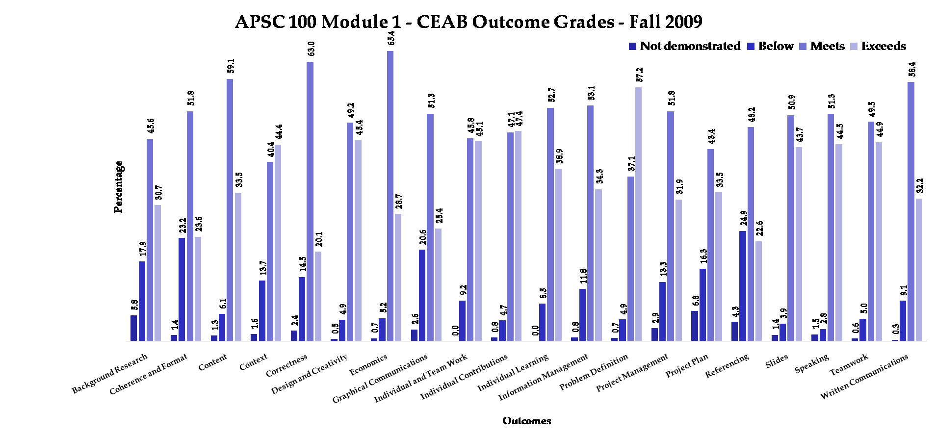
Results: example

Slide 69
Program-wide assessment process flow
Identify major
objectives (including
graduate attributes)
Identify
indicators
Program
improvement
Stakeholder input
Map to courses/
experiences
Analyze and
evaluate data
Course changes/
Measure
Identify appropriate
tools to assess
(reports, simulation,
tests,...)

Slide 70
Program improvement
Changes in existing courses
New courses/streams (Queen's is going through this)
  Integrative experience
  Design
New approaches
  service learning
  co-ops
  case-study
  problem-based learning
  model eliciting activities…

Slide 71
Discuss:
How will you proceed in your department?
Who needs to be involved?
What courses/ experiences are starting points?
From P. Wolf, New Directions for Teaching and Learning,
Volume 2007, Issue 112 (p 15-20). Used with permission.

Slide 72
Faculty buy-in
Faculty reaction skeptical to negative at first, but after 4-5 years value often perceived in outcomes assessment (US experience)
Often takes some time to understand rationale for criteria
Takes about 18 months to setup assessment process

Slide 73
General advice
Capitalize on what you're already doing: innovators, first adopters, experimenters
Dean/chair support can help encourage large scale curriculum development
Start from the question “what do we want to know to improve our program”, rather than “what does CEAB want us to do” – think of this as self-directed learning!
Don't generate reams of data that you don't know what to do with: create information, not data

Slide 74
Future support: EGAD Project
Developing workshops, case studies, guidelines, and recommended processes to share
Facilitating discussion between schools
Clearinghouse for resources developed across country
Offering support to programs as they prepare for accreditation
Working cooperatively with CEAB
Resources will be posted on website as they become available: http://engineering.queensu.ca/egad

Slide 75
Conclusion
Use and share ideas:
  Regional collaboration
  Publication of processes/plans at Canadian Engineering Education Association (CEEA) conferences
  EGAD
Training opportunities for curriculum chairs, etc.:
  ABET Institute for Development of Excellence in Assessment Leadership

Slide 76
Discussion

