Slide 1
Graduate Attribute Assessment Workshop
Brian Frank
Director (Program Development)
Faculty of Engineering and Applied Science
Queen's University
May 8, 2011

Slide 2
Objectives
Answer: What is the “outcomes assessment” or “graduate attribute” expectation all about?
Understand CEAB’s requirements for graduate attribute assessment
Be able create a process to assess graduate attributes

Slide 3
Administrative issues
Slides and summary handout will be posted to EGAD website http://engineering.queensu.ca/egad
Other support and resources will described at the end
Will provide a summary handout for reference (terminology, process)
Active workshop - feel free to ask questions or comment throughout

Slide 4
Graduate attributes => Quality assurance process
CEAB is requiring each program to create and apply a quality assurance process to improve the program
Like any QA process, it examines the outputs of a process – in this case, the abilities of graduating engineering students
Compared to traditional CEAB approach: much less prescriptive
  Pro: more flexibility for programs
  Con: less guidance, more uncertainty. “What do they want to see?”

Slide 5
Graduate attribute assessment
Outcomes assessment is used to answer questions like:
What can students do?
How does their performance compare to our stated expectations?
It identifies gaps between our perceptions of what we teach and what knowledge, skills, and attitudes students develop program-wide.

Slide 6
Inputs and Outcomes
Inputs Student pre-university background Faculty education, professional status Ongoing faculty development Class sizes Content Campus resources Contact hours Laboratory equipment Support services | Outcomes Demonstrated abilities (cognitive, skills, attitudes)

Slide 7
Broader push for outcomes assessment
Accreditation bodies in most industrialized countries use outcomes-based assessment to demonstrate their students' capabilities.
Washington Accord: allows substantial equivalency of graduates from Australia, Canada, Hong Kong, Republic of Ireland, New Zealand, South Africa, United Kingdom, and United States, Japan, Singapore,Korea, and Chinese Taipei
Ontario: University Undergraduate Degree Level Expectations (UUDLEs), Graduate Degree Level Expectations (GDLEs) will assessed in all programs, fortunately overlap graduate attributes

Slide 8
University Undergraduate Degree Level Expectations
    Depth and Breadth of Knowledge
    Knowledge of Methodologies
    Application of Knowledge
    Communication Skills
    Awareness of Limits of Knowledge
    Autonomy and Professional Capacity

Slide 9
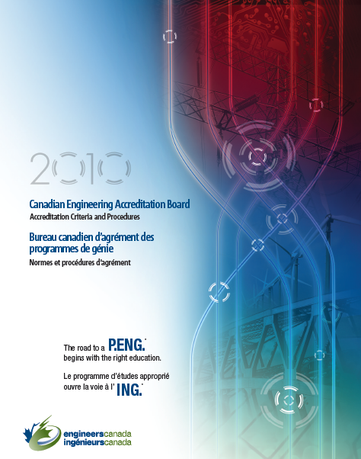
Perspective: Sec 3.1 of CEAB Procedures
“The institution must demonstrate that the graduates of a program possess the attributes under the following headings... There must be processes in place that demonstrate that program outcomes are being assessed in the context of these attributes, and that the results are applied to the further development of the program.”

Slide 10
12 graduate attributes
Knowledge base for engineering
Problem analysis
Investigation
Use of engineering tools
Design
Individual and team work
Communication skills
Professionalism
Impact on society and environment
Ethics and equity
Economics and project management
Lifelong learning

Slide 11
CEAB GA assessment instructions (2010)
Describe the processes that are being or are planned to be used. This must include:
a set of indicators that describe specific abilities expected of students to demonstrate each attribute
where attributes are developed and assessed within the program…
how the indicators were or will be assessed. This could be based on assessment tools that include, but are not limited to, reports, oral presentations, …
evaluation of the data collected including analysis of student performance relative to program expectations
discussion of how the results will be used to further develop the program
a description of the ongoing process used by the program to assess and develop the program as described in (a)-(e) above

Slide 12

Setting up a process
(without overwhelming faculty, irritating staff,
and going deeper into debt)

Slide 13
Aside: Idealistic course development process
Identify course
objectives and
content
Create specific
outcomes for each
class
Course
improvement
Student input
Map to experiences
(lectures, projects,
labs, etc.)
Analyze and
evaluate data
Deliver, grade,
seek feedback
Identify appropriate
tools to assess
(reports, simulation,
tests,...)
Notes:
If we begin by talking about Outcomes-based assessment and curriculum review, it might be best to keep the language consistent by referring to class outcomes rather than objectives

Slide 14
Program-wide assessment process flow
Identify major
objectives (including
graduate attributes)
Create
Indicators
Program
improvement
Stakeholder input
Map to courses/
experiences
Analyze and
evaluate data
Course changes/
Measure
Identify appropriate
tools to assess
(reports, simulation,
tests,...)
Notes:
I changed Performance Indicators to “Indicators” as per CEAB Questionnaire and our Glossary of Terms. Should it read “Attribute Indicators” or do you think it’s implicit?

Slide 15
Program-wide assessment process flow
Identify major
objectives (including
graduate attributes)
Create
Indicators
Program
improvement
Stakeholder input
Map to courses/
experiences
Analyze and
evaluate data
Course changes/
Measure
Identify appropriate
tools to assess
(reports, simulation,
tests,...)
Notes:
As per CEAB Questionnaire and our glossary of terms, changed “performance indicators” to “Indicators”

Slide 16
Creating Program objectives
CEAB graduate attributes
Strategic plans
Advisory boards
Major employers of graduates
Input from stakeholders
Focus groups, surveys
SWOT (strengths, weaknesses, opportunities, threats) analysis
What do you want your program to be known for?

Slide 17
Program-wide assessment process flow
Identify major
objectives (including
graduate attributes)
Create
Indicators
Program
improvement
Stakeholder input
Map to courses/
experiences
Analyze and
evaluate data
Course changes/
Measure
Identify appropriate
tools to assess
(reports, simulation,
tests,...)
Notes:
As per the CEAB Questionnaire etc, changed “performance indicators” to “Indicators”

Slide 18
Why indicators?
Lifelong learning
An ability to identify and address their own educational needs in a changing
world in ways sufficient to maintain their competence and to allow them to
contribute to the advancement of knowledge
Can this be directly
measured?
Would multiple assessors
be consistent?
How meaningful would
the assessment be?
Probably not, so more specific measurable indicators are needed.
This allows the program to decide what is important

Slide 19
Indicators: examples
Lifelong learning
An ability to identify and address their own educational needs in a changing
world in ways sufficient to maintain their competence and to allow them to
contribute to the advancement of knowledge
Graduate
attribute
The student:
Critically evaluates information
for authority, currency, and
objectivity
Identify gap in knowledge and
develop a plan to address
Indicators
Describes the types of literature of
their field and how it is produced
Uses information ethically and legally
to accomplish a specific purpose
Notes:
I changed performance indicators to Indicators
BTW one of the critical indicators of a student’s ability to engage in Lifelong Learning is their ability to identify gaps in their knowledge and skill sets and create a plan to address them

Slide 20
Establishing Indicators
What specific things should students demonstrate?
What do they need to be able to do?
Are they measurable and meaningful?
Can involve cognitive (recalling, analyzing, creating), attitudes, skills
Level of expectation
(“describes”, “compares”, “applies”, “creates”, etc.)
Content area
Critically evaluates information for authority, currency, and
objectivity

Slide 21
Indicators
A well-written indicator includes:
what students will do
the level of complexity at which they will do it
the conditions under which the learning will be demonstrated

Slide 22
Indicators
Knowledge base for engineering
Critically select* and apply* computational formula to solve novel problems
(Performance on benchmark like force concept inventory)
Engineering tools
Demonstrate use of a schematic capture and simulation tool to analyze analog and digital circuits
Demonstrate use of a digital oscilloscope to analyze common signals in time and frequency domain

Slide 23
Problematic indicators
What does the author mean? Students can state
the laws? Plug numbers into equations? Apply laws
to solve conceptual problems? ...
Content area
Learns static physics principles including Newtonian laws
for linear motion

Slide 24
Taxonomy
Creating
(design, construct, generate ideas)
Evaluating
(critique, judge, justify decision)
Analyzing
(compare, organize, differentiate)
Applying
(use in new situation)
Understanding
(explain, summarize, infer)
Remembering
(list, describe, name)
Anderson, L. W. and David R. Krathwohl, D. R., et al (Eds..) (2001) A Taxonomy for Learning, Teaching, and Assessing: A Revision of Bloom's Taxonomy of Educational Objectives. Allyn & Bacon. Boston, MA (Pearson Education Group

Slide 25
Verbs for cognitive skills
Define
List
State
Recall
Identify
Recognize
Calculate
Label
Locate
Interpret
Compare
Contrast
Solve
Estimate
Explain
Classify
Modify
Integrate
Analyze
Hypothesize
Evaluate
Justify
Develop
Create
Extrapolate
Design
Critique
Higher order skills

Slide 26
Outcomes at Blooms’ Levels (Romkey, McCahan):
Knowing: Define the concepts of engineering stress and engineering strain.
Understanding: Explain Hooke’s Law in your own words and describe the conditions under which it is applicable.
Applying: Utilize Poisson’s Ratio to calculate lateral strain given a longitudinal loading situation.
Analysing: Discuss the specific characteristics of the microstructure that render the stress-strain behaviour of a polymeric material as brittle, plastic, or elastic.
Synthesizing: Investigate recyclability/disposability issues relative to (a) metals, (b) glass, (c) polymers, and (d) composites.
Creating: Argue the economic viability of the “green design” philosophy of product design.
26
Notes:
26
Objective/Outcomes decisions to be made

Slide 27
Defining Indicators for your Program (10 min)
In groups of 2-4:
  Select a graduate attribute
  Independently create some indicators for that attribute that reflect your program objectives
  Discuss indicators at your table. Are they measurable? Are they meaningful? Would the assessment of them be consistent from one rater to another?

Slide 28
Follow-up to identifying Indicators
Any points for discussion?

Slide 29
Resources on Indicators
EC2000, ABET 2009
UK-SPEC, Engineering Subject Centre Guide
Engineers Australia
CDIO
Foundation Coalition
UDLEs
IET criteria for ECE
Note: Indicators may also be known as:
Assessment criteria
Performance criteria
Outcomes
Competencies
Objectives
Many linked at:
http://bit.ly/9OSODq
(case sensitive, no zeros)

Slide 30
ECE indicators
E.g. IEE (now IET) describes requirements for UK BEng and MEng programs
http://www.theiet.org/careers/accreditation/academic/downloads/handbook.cfm?type=pdf

Slide 31
Program-wide assessment process flow
Identify major
objectives (including
graduate attributes)
Identify
Indicators
Program
improvement
Stakeholder input
Map to courses/
experiences
Analyze and
evaluate data
Course changes/
Measure
Identify appropriate
tools to assess
(reports, simulation,
tests,...)

Slide 32
Where can we assess students?
Courses
Co-ops/internships
Co-curricular activities (competitive teams, service learning, etc.)
Exit or alumni surveys/interviews
...

Slide 33
Curriculum Mapping
Important to know where students (a) develop attributes and (b) are assessed
In a typical program the courses involved in assessing students are a small subset of courses. This might include a few courses from areas including:
  Engineering science
  Laboratory
  Complementary studies
  Project/experiential based

Slide 34
Curriculum mapping surveying
U Guelph developing Currickit: Curriculum Mapping Software
  Online survey, completed by each instructor, to describe whether an attribute is developed, assessed, or both
  Software collects data and reports on attributes in the program
U Calgary surveyed instructors to find out where attributes are Introduced, Developed, or Utilized (ITU) in courses

Slide 35
Two approaches to mapping
Attributes to courses
“We know what we want the program to look like – how well do the attributes line up with our curriculum?”
Courses to attributes
“Let’s do a survey of our instructors, and determine experiences appropriate to developing and assessing attributes.”
Can do this one way or both ways

Slide 36
ITU Analysis (UCalgary): Introduced

Slide 37
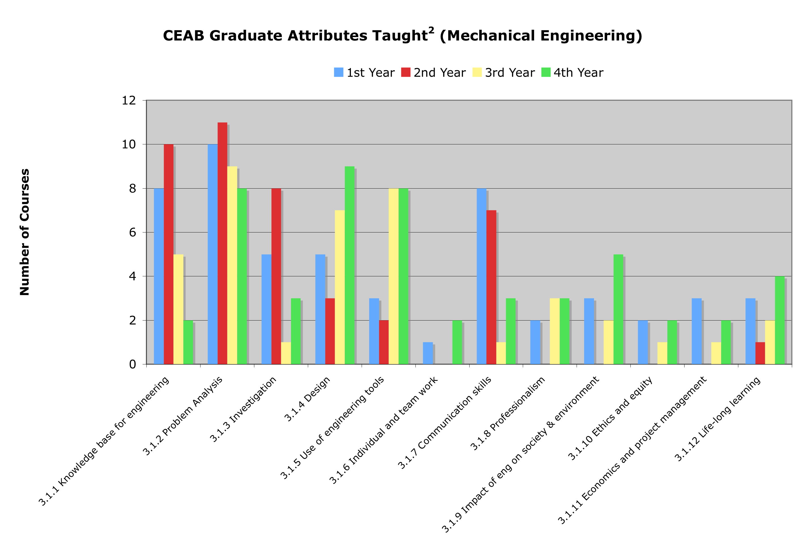
ITU Analysis: Taught

Slide 38
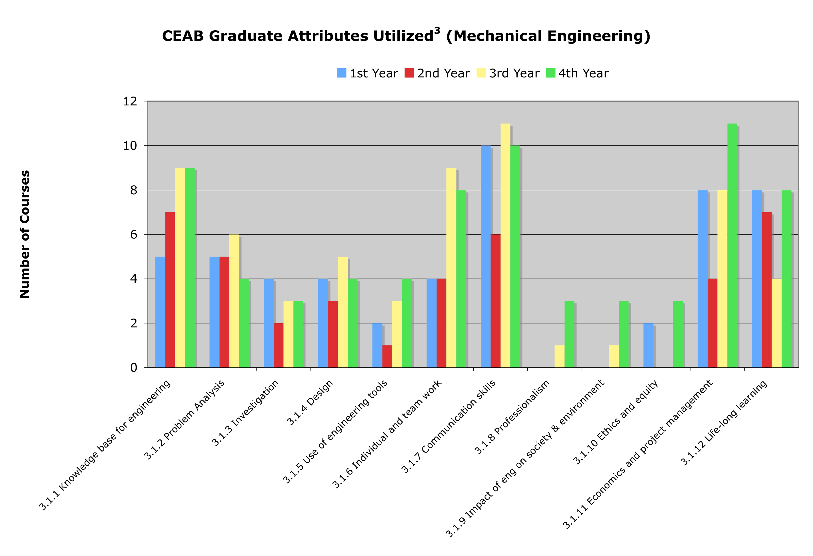
ITU Analysis: Utilized

Slide 39
Attributes to courses: Lifelong learning
Indicator | Developed | Assessed | Assessment tool(s)
Critically evaluates procured information for authority, currency, and objectivity | APSC-100 MECH-212 MECH-460 | MECH-460 | Project proposal report
 |  | MECH 490 | Oral exam
Describes professional and academic societies in the discipline and how new knowledge enters discipline. | APSC-100 MECH-270 MECH-333 MECH-490 | MECH-490 | Undergraduate thesis
Identifies resources and professional associations that address own ongoing professional development. | MECH-270 MECH-490 Co-op | MECH-490 | Pre-graduation interview
 |  | Co-op | Post co-op report

Slide 40
Courses to attributes: First year
Course | Grad Attributes Supported | Instructional Methods | Assessment tool(s)
APSC-100 (Engineering practice) | Communication Individual & Team Work Professionalism Lifelong Learning Problem analysis (open-ended) Investigation Ethics and equity | Design project Experimental project Model eliciting activity | Project reports Oral presentations Peer evaluations Supervisor evaluation All rubric-based
APSC-171 (Calculus I) | Knowledge Problem analysis (closed-ended) | Lecture, independent work | Targeted question on final exam

Slide 41
Example: ABET recommends mapping tables
Indicator | Developed in: | Assessment Method | Measured in: | Time measured | Assessment coordinator | Evaluation
Produces research information for the team | ME113, EM213, ME213, ME235, ME333, ME412 | Portfolios Peer Evaluations, Faculty Evaluations | ME 213 ME412 | ME 213 Even ME412 Odd | Even – Armaly Odd - Richards | Curriculum Committee
Demonstrates understanding of team roles when assigned | ME113, EM213, ME213, ME235, ME333, ME412 | Peer Evaluations, Faculty Evaluations | ME 213 ME412 | ME 213 Even ME412 Odd | Even – Armaly Odd - Richards | Curriculum Committee
Shares in the work of the team | ME113, EM213, ME213, ME235, ME333, ME412 | Peer Evaluations, Faculty Evaluations | ME 213 ME412 | ME 213 Even ME412 Odd | Even – Armaly Odd - Richards | Curriculum Committee
Demonstrates good listening skills | ME113, EM213, ME213, ME235, ME333, ME412 | Peer Evaluations, Faculty Evaluations | ME213 ME412 | ME 213 Even ME412 Odd | Even – Armaly Odd - Richards | Curriculum Committee

Slide 42
Program-wide assessment process flow
Identify major
objectives (including
graduate attributes)
Identify
indicators
Program
improvement
Stakeholder input
Map to courses/
experiences
Analyze and
evaluate data
Course changes/
Measure
Identify appropriate
tools to assess
(reports, simulation,
tests,...)

Slide 43
Assessment tools
How to measure learning against specific expectations?
Direct measures – directly observable or measurable assessments of student learning
  E.g. Student exams, reports, oral examinations, portfolios, etc.
Indirect measures – opinion or self-reports of student learning or educational experiences
  E.g. grades, student surveys, faculty surveys, focus group data, graduation rates, reputation, etc.

Slide 44
Assessment tools
Local written exam
(e.g. question on final)
External examiner
(e.g. Reviewer on design projects)
Standardized written exam
(e.g. Force concept inventory)
Oral exam
(e.g. Design projects presentation)
Performance appraisal
(e.g. Lab skill assessment)
Oral interviews
Simulation
(e.g. Emergency simulation)
Surveys and questionnaires
Behavioural observation
(e.g. Team functioning)
Focus group
Portfolios
(student maintained material addressing
outcomes)
Archival records
(registrar's data, previous records, ...)

Slide 45
Instructors: “We do assess outcomes – by grades”
How well does the program prepare
students to solve open-ended
problems?
Student transcript
Electric Circuits I Electromagnetics I Signals and Systems I Electronics I Electrical Engineering Laboratory Engineering Communications Engineering Economics ... Electrical Design Capstone | 78 56 82 71 86 76 88 86
Are students prepared to continue
learning independently after
graduation?
Do students consider the social
and environmental implications of
their work?
What can students do with
knowledge (plug-and-chug vs.
evaluate)?
Course grades usually aggregate
assessment of multiple objectives,
and are indirect evidence for
some expectations

Slide 46
External assessment tools
Concept inventories (Force Concept Inventory, Statics concept inventory, Chemistry Concept Inventory, …)
Surveys of learning, engagement, etc.
  National Survey of Student Engagement (National data sharing, allowing internal benchmarking), E-NSSE
  Course Experience Questionnaire
  Approaches to Studying Inventory
  Academic motivation scale
  Engineering attitudes survey

Slide 47
Targets and thresholds
Need to be able to explain what level of performance is expected of students
Useful to consider the minimum performance expectation (threshold) and what a student should be able to do (target)
Rubrics can be very useful

Slide 48
Rubrics
Scales Dimensions | Not demonstrated | Marginal | Meets expectations | Exceeds expectations
Dimension 1: Information | Descriptor | Descriptor | Descriptor | Descriptor
Dimension 2: Design | Descriptor | Descriptor | Descriptor | Descriptor
Dimension 3: Communications | Descriptor | Descriptor | Descriptor | Descriptor
Improve inter-rater reliability
Describe expectations for instructor and students

Slide 49
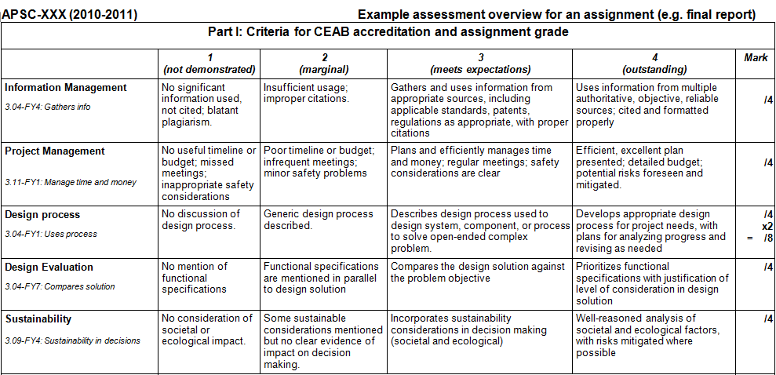
Rubric example
threshold
target
Creating defined levels (“scales”) of expectations reduces variability between graders, makes expectations clear to students

Slide 50
Task: Assessment tools (5 min)
Take some assessment criteria developed by group previously:
  Determine three ways that they could be assessed (a list of assessment tools are on summary sheet), at least one done using a direct assessment tool
  If any are difficult to measure, consider whether the criteria should be modified

Slide 51
Example: Knowledge assessment
Calculus instructor asked questions on exam that specifically targeted 3 indicators for “Knowledge”:
  “Create mathematical descriptions or expressions to model a real-world problem”
  “Select and describe appropriate tools to solve mathematical problems that arise from modeling a real-world problem”
  “Use solution to mathematical problems to inform the real-world problem that gave rise to it”
Notes:
51

Slide 52
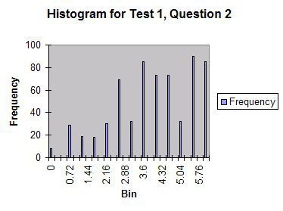
Indicator 1:
The student can create and/or select mathematical descriptions or expressions for simple real-world problems involving rates of change and processes of accumulation (overlaps problem analysis)
Context: calculating
Intersection of two
trajectories

Slide 53
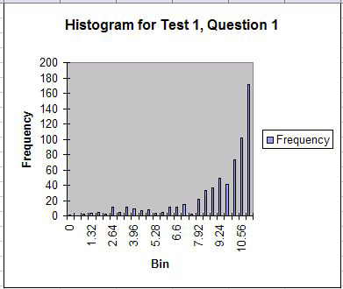
Indicator 2:
Students can select and describe appropriate tools to solve the mathematical problems that arise from this analysis
Context: differentiation
similar to high school
curriculum

Slide 54
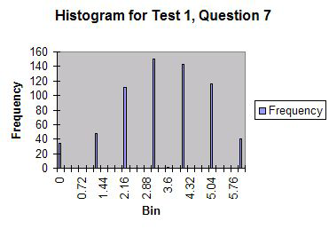
Indicator 2:
Students can select and describe appropriate tools to solve the mathematical problems that arise from this analysis
Context: implicit
differentiation, trig
inverse

Slide 55
Example: Knowledge assessment
Physics course instructors administering the Force Concept Inventory (FCI) before and after course in mechanics to assess conceptual understanding
Allows for benchmarking, which is difficult to do for most other indicators.
Notes:
55

Slide 56
Program-wide assessment process flow
Identify major
objectives (including
graduate attributes)
Identify
indicators
Program
improvement
Stakeholder input
Map to courses/
experiences
Analyze and
evaluate data
Course changes/
Measure
Identify appropriate
tools to assess
(reports, simulation,
tests,...)

Slide 57
Principles of Measurement
Not required to measure every attribute every year. Could measure in years of accreditation cycle as follows:
  Design: Years 1,4
  Communications: Years 2,5
  Knowledge: Years 3,6...
No requirement to assess every student – appropriate sampling may be appropriate for some assessment measures
Assessment is for the program

Slide 58
Is this data useful?
Validity: how well an assessment measures what it is supposed to
  Direct measures vs. indirect
  Authentic assessment (emulating professional practice)
Reliability: the degree to which an instrument measures the same way each time it is used under the same condition with the same subjects;
  the repeatability of the measurement
  a measure is considered reliable if a person's score on the same test given twice is similar
  Estimated by test/retest, or internal consistency using multiple methods to assess same criteria

Slide 59
Data gathering and storage
Modern learning management systems are able to link outcomes to learning activities
E.g. Moodle, Blackboard, Desire2Learn
Reports, assignments, quizzes in the LMS can be linked to outcomes and simultaneously graded for course marks and assessment criteria

Slide 60
E.g. Assessment on exam
Exam based questions can be a non resource-intensive method of assessing for some outcomes
Appropriate for “knowledge”, “problem analysis”
Can be used as “easy wins” for some things

Slide 61
Student perspectives
Student surveys and focus groups give student perspective on development of attributes
What attributes do they think are being most/least developed in the program?
Duplication
Ideas on how to have students take some responsibility for demonstrating attributes

Slide 62
Program-wide assessment process flow
Identify major
objectives (including
graduate attributes)
Identify
indicators
Program
improvement
Stakeholder input
Map to courses/
experiences
Analyze and
evaluate data
Course changes/
Measure
Identify appropriate
tools to assess
(reports, simulation,
tests,...)

Slide 63
Now that we have data… analyze and evaluate
Could do:
Longitudinal comparison of students
Histogram of results by level (did or did not meet expectations)
Analysis of which areas are weakest
Triangulation: examination of correlation between results on multiple assessments of the same indicator (e.g. compare focus group data with exam results)

Slide 64
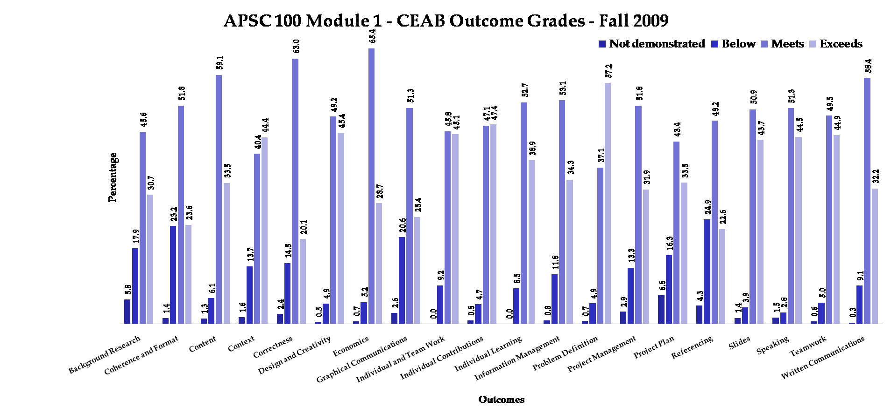
Results: example

Slide 65
Program-wide assessment process flow
Identify major
objectives (including
graduate attributes)
Identify
indicators
Program
improvement
Stakeholder input
Map to courses/
experiences
Analyze and
evaluate data
Course changes/
Measure
Identify appropriate
tools to assess
(reports, simulation,
tests,...)

Slide 66
Program improvement
Changes in existing courses
New courses/streams (Queen's is going through this)
  Integrative experience
  Design
New approaches
  service learning
  co-ops
  case-study
  problem-based learning
  model eliciting activities…

Slide 67
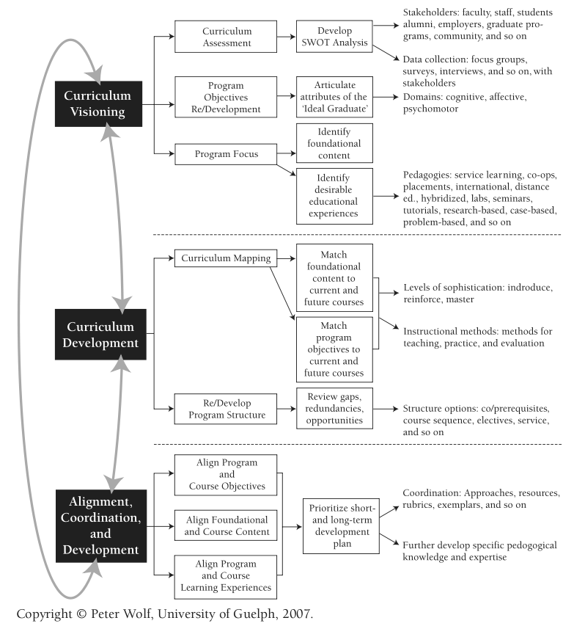
Discuss:
How will you proceed in your department?
Who needs to be involved?
What courses/ experiences are starting points?
From P. Wolf, New Directions for Teaching and Learning,
Volume 2007, Issue 112 (p 15-20). Used with permission.

Slide 68
Faculty buy-in
Faculty reaction skeptical to negative at first, but after 4-5 years value often perceived in outcomes assessment (US experience)
Often takes some time to understand rationale for criteria
Takes about 18 months to setup assessment process

Slide 69
General advice
Capitalize on what you're already doing: innovators, first adopters, experimenters
Dean/chair support can help encourage large scale curriculum development
Start from the question “what do we want to know to improve our program”, rather than “what does CEAB want us to do” – think of this as self-directed learning!
Don't generate reams of data that you don't know what to do with: create information, not data

Slide 70
Future support: EGAD Project
Developing workshops, case studies, guidelines, and recommended processes to share
Facilitating discussion between schools
Clearinghouse for resources developed across country
Offering support to programs as they prepare for accreditation
Working cooperatively with CEAB
Resources will be posted on website as they become available: http://engineering.queensu.ca/egad

Slide 71
Conclusion
Use and share ideas:
  Regional collaboration
  Publication of processes/plans at Canadian Engineering Education Association (CEEA) conferences
  EGAD
Training opportunities for curriculum chairs, etc.:
  ABET Institute for Development of Excellence in Assessment Leadership

Slide 72
Discussion

Slide 73
Graduate Attribute Assessment:
Year 1 Pilot at Queen's University
Brian Frank
Director (Program Development)
Faculty of Engineering and Applied Science
Queen's University
June 7, 2010

Slide 74
Queen's Engineering:Long-term goals
Establish criteria that are meaningful and measurable (directly or indirectly)
Criteria measured using multiple methods or events to assess validity
Graduate attributes measured at multiple times in students' program with leveled expectations
Satisfy expectations of both CEAB and province (OCAV UDLEs)
Specific
Triangulated
Leveled
Multi-use
Notes:
74

Slide 75
Queen's University process
Spring 2009: Gather relevant resources (e.g. research, other accreditation guidelines)
Summer 2009: Working groups of faculty, students, topical experts created specific program-wide assessment criteria (next slide)
Summer 2009: Setup learning management system (Moodle) to manage assessments
Sept-April 2009: Piloting assessment in first year
Notes:
75

Slide 76
Working groups
Queen's process is driven by faculty for improving the program, not just for accreditation purposes
“What do we want our students to be able to do, and what data would we like to have to improve the program?”
Asked instructors, undergraduate chairs, topical experts to participate in creating assessment criteria, including some “skeptics”
7 working groups formed, covering 12 graduate attributes
Working groups met for 1 hour 3-4 times, developed initial assessment criteria

Slide 77
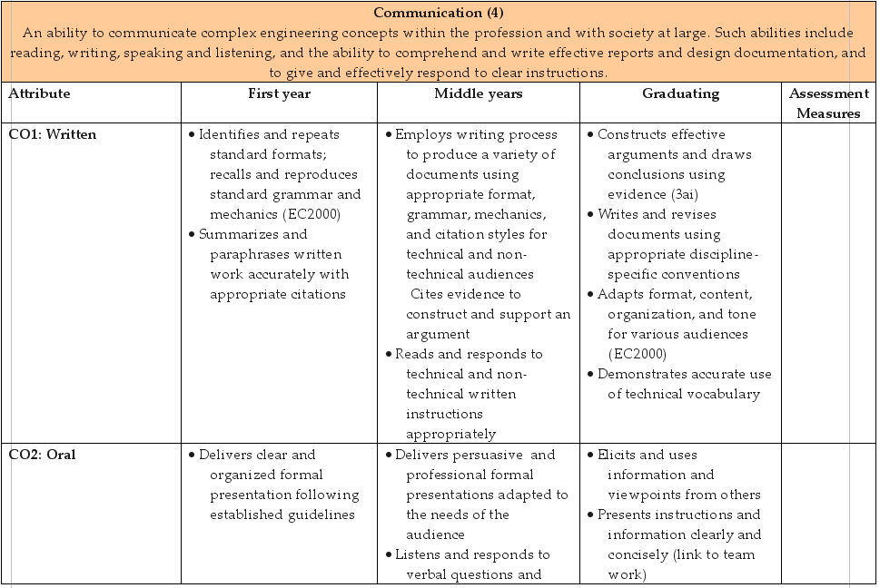
Assessment criteria
Linkage to OCAV UDLEs
Graduate attribute
levels
categories
Notes:
77

Slide 78
Indicator mapping
Assessment
Criteria
First year courses
Design
Physics
Calculus
Chemistry
etc.
First year
Design project course
Assignment 1
used to assess:
Criteria 1
Criteria 2
Criteria 3
Assignment 2
used to assess:
Criteria 1
Criteria 4
Criteria 5
Team proposal
used to assess:
Criteria 1
Criteria 6
Criteria 7
etc.
Middle years
Graduating year
Notes:
78

Slide 79
Course implementation
Criteria compared to first year design and professional skill course (APSC-100), and course deliverables adapted to meet objectives
Indicators entered into Moodle, linked to assignment submissions
When students uploaded assignments/reports, grading was automatically tied to outcomes in Moodle (discussed later)
Two first year engineering science and math courses assessed on final exams

Slide 80
Linking indicators to courses

Slide 81
Specific examples
Professional skills assessment using rubric
Communication skills assessment using rubric
Knowledge assessment on calculus exam
Problem analysis assessment on chemistry exam
Notes:
81

Slide 82
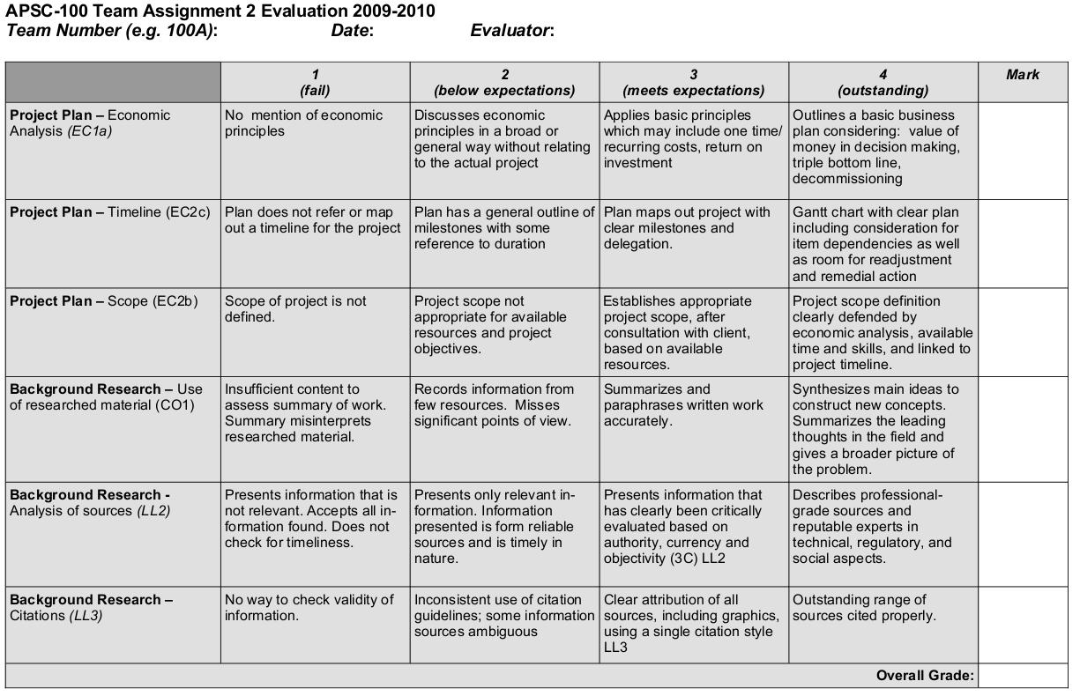
Example 1. Professional skills assessment on an assignment
Assessing
Avoid extra work: assess criteria as part of assignment/report grading
Assignment uses program-wide assessment criteria as expectations for grades.
Allow simultaneous grading for (1) course and (2) graduate attribute assessment.
Notes:
82

Slide 83
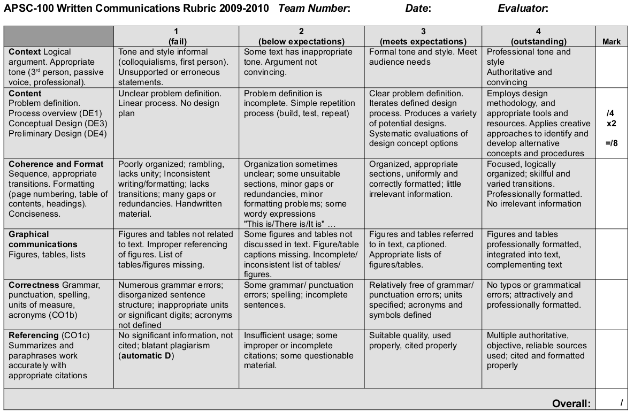
Example 2. Communication assessment on a report
Assessing
Report requirements use program-wide assessment criteria as expectations for grades.
Allow simultaneous grading for (1) course and (2) graduate attribute assessment.
Notes:
83

Slide 84
Technology support:
Learning management systems and outcomes

Slide 85
Learning management systems
Blackboard: measurement instruments, reporting and tracking
Desire2Learn: “Competencies” tools
Sakai: outcomes, portfolio strength
Moodle: outcomes
  Show how outcomes managed in Moodle

Slide 86
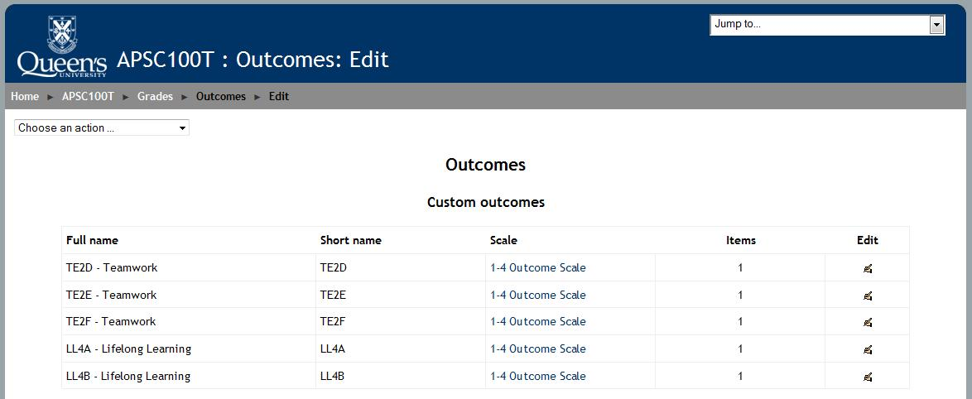
Selected assessment criteria (“outcomes”)
Queen's identifiers for assessment criteria

Slide 87
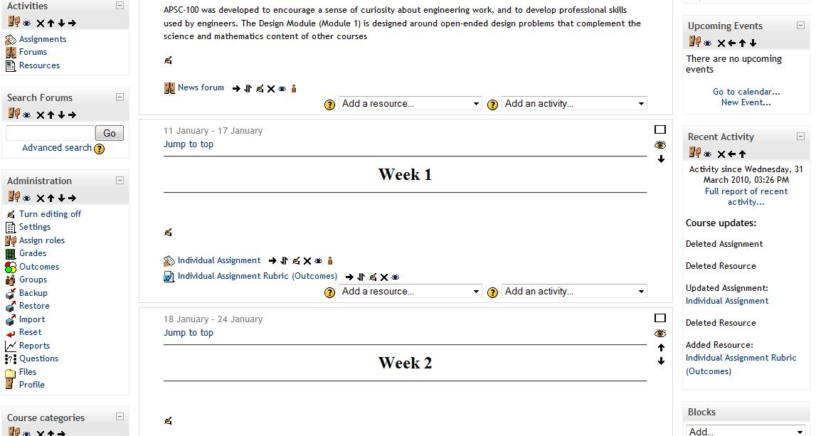
Moodle online assignments

Slide 88
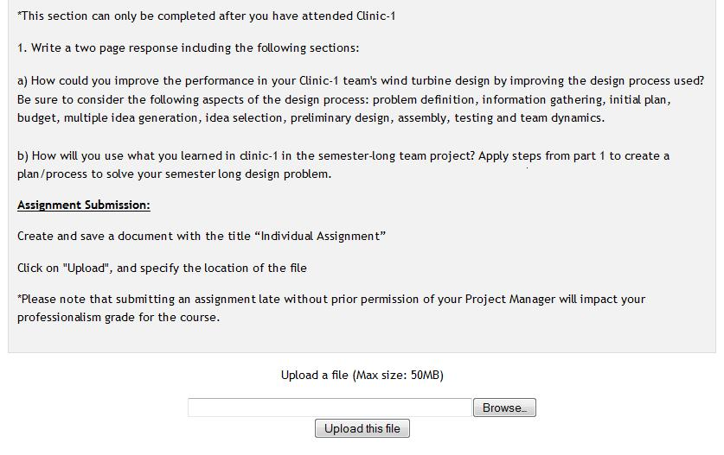
Assignment upload

Slide 89
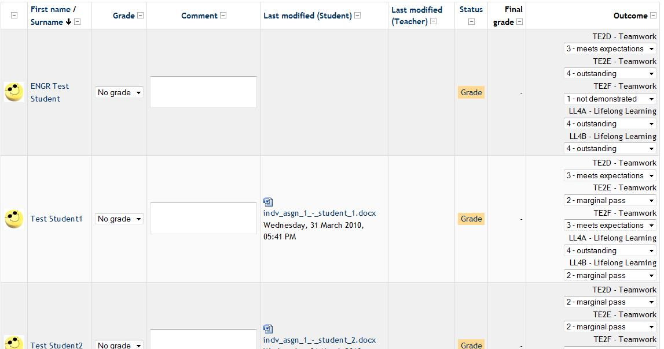
Outcome grading for assignments

Slide 90
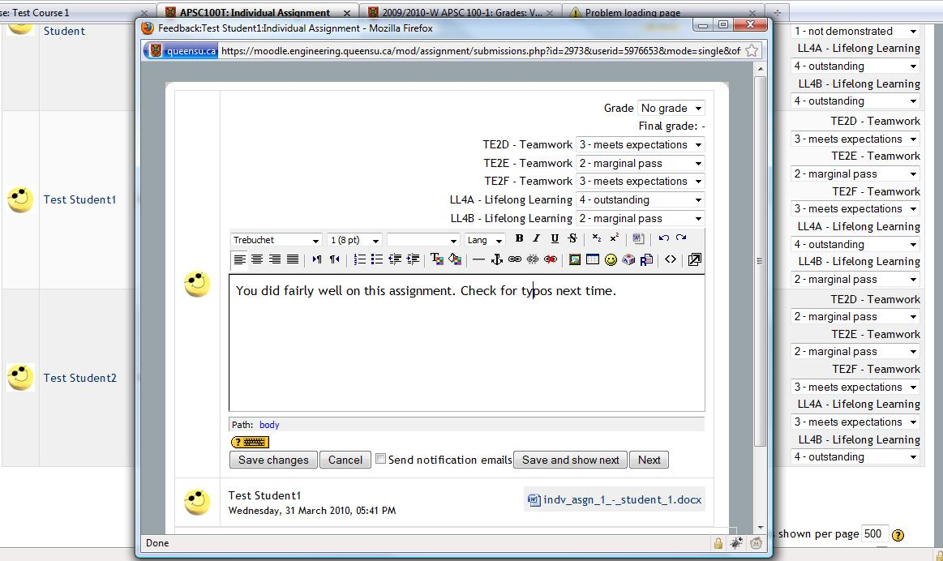
Outcome grading - popup

Slide 91
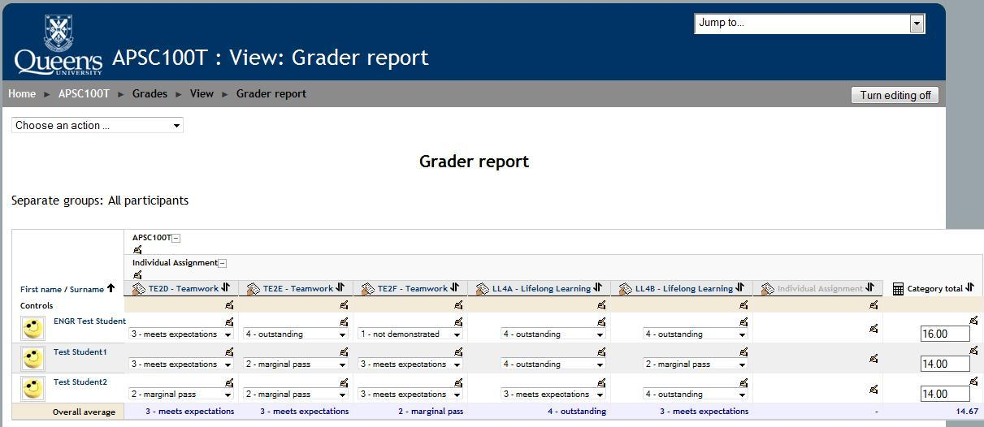
Gradebook report by outcome

Slide 92
Moodle development
Customizing Moodle for our purposes
  Group upload/grading of assignments
  Peer evaluation
  Class response system (“clickers”)
Future collaboration

Slide 93
Example 3: Knowledge assessment
Calculus instructor asked questions on exam that specifically targeted 3 assessment criteria for “Knowledge”:
  “Create mathematical descriptions or expressions to model a real-world problem”
  “Select and describe appropriate tools to solve mathematical problems that arise from modeling a real-world problem”
  “Use solution to mathematical problems to inform the real-world problem that gave rise to it”
Notes:
93

Slide 94
Example 3: Knowledge assessment
Calculus exam organized to allow three criteria to be assessed independently:
  Students asked to create equation(s) that model a physical system.
  Students asked to solve a mathematical expression (“typical” mathematics)
  Interpret the meaning of an equation that models a physical system
Marks on those questions used to assess student ability to meet expectations.
Notes:
94

Slide 95
Example 4: Problem analysis assessment
Chemistry instructor asked questions that specifically targeted outcomes for Problem analysis
  “Makes valid assumptions and grounded approximations based on available information in solving under-defined problems”
Students asked to solve enthalpy change question, with explicit assumption
Afterward 2 multiple choice questions asked how valid the assumption was
10% below expectations, 40% met expectations, 43% exceeded expectations
Notes:
95

Slide 96
Histogram of results in First year design course
Use to evaluate how well students meet expectations and to improve program
Notes:
96

Slide 97
Resources/time commitment
Creating assessment criteria: 7 committees of approximately 5 people who each met about 4 times
Mapping criteria to a course and creating rubrics for assessment: ~ 10 hours
Large scale curricular changes: ~10 person committee, most of whom had 1 course relief bought out by dean
Coordination (resource gathering, planning, curricular planning): ~40% of a position

Slide 98
Graduating year process (September 2010)
Forming group of capstone course instructors to look at sharing resources
Develop discipline-specific expectations on top of program wide expectations
Assess most professional skills in capstone courses

Slide 99
Conclusion
Resources
Assessment criteria
Technology support

